Slide 1
Infosys springboard Virtual Internship 6.0
Team Details:
Project Name: Food Trends: Understanding Customer Preferences in F&B
Group ID: Batch-11, Group 1, Team-A
Mentor/Guide: Nityasree
Done by:
Harshini G

Slide 2
Title and Objective
Project Title: FoodTrends: Understanding Customer Preferences in F&B
Objective:
To examine evolving consumer behavior in the post-pandemic Food & Beverage (F&B) market.
To identify the primary factors influencing food choices, including health awareness, convenience, brand perception, and pricing.
To deliver data-driven insights and recommendations that help F&B brands improve customer engagement and retention

Slide 3
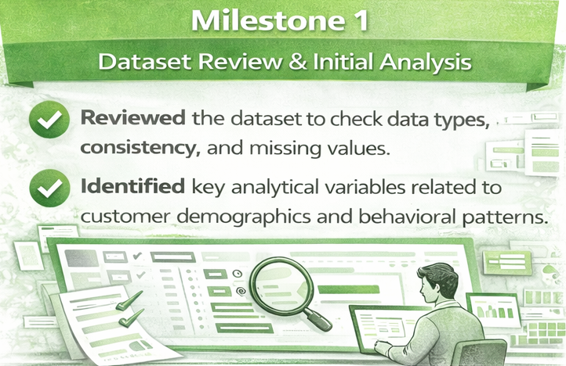
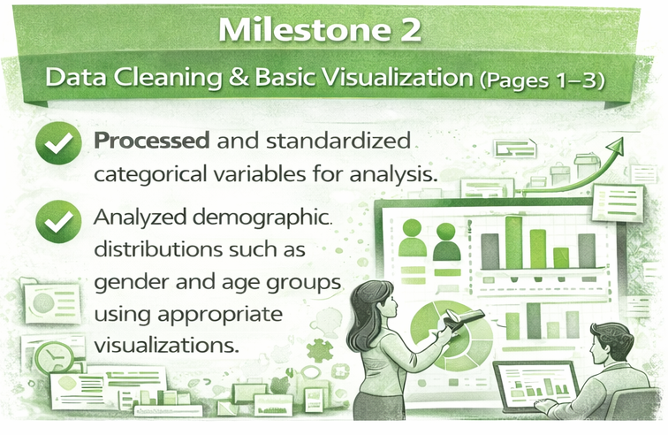
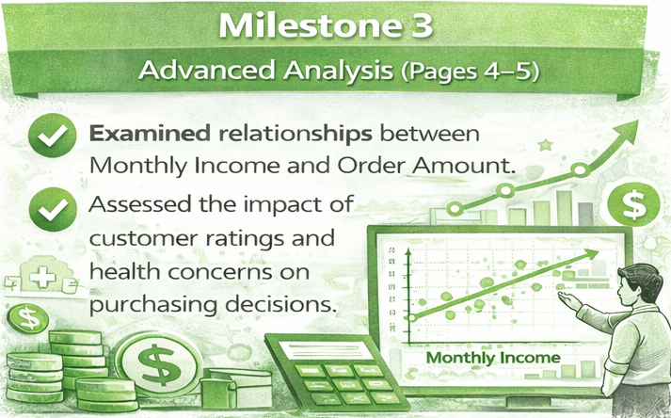
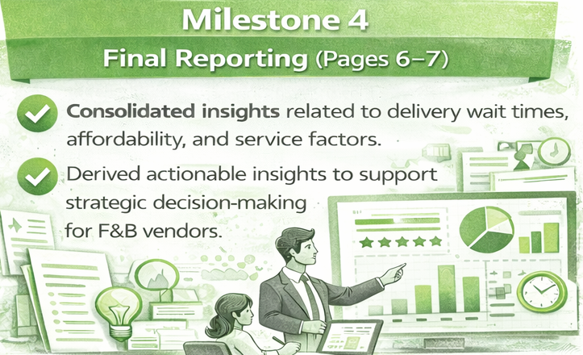
Project Milestones

Slide 4
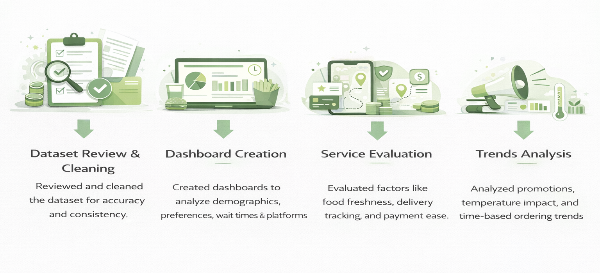
Project Execution
Dataset Source: The dataset (order final.xlsx) consists of 388 customer order records with 35 attributes, covering customer demographics, order details, and preference indicators such as Age, Gender, Monthly Income, Ratings, and Food Preferences.

Slide 5
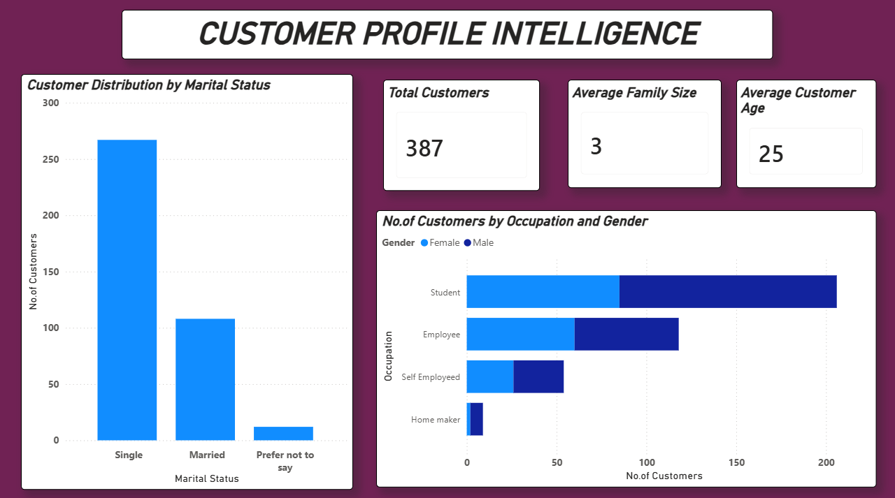
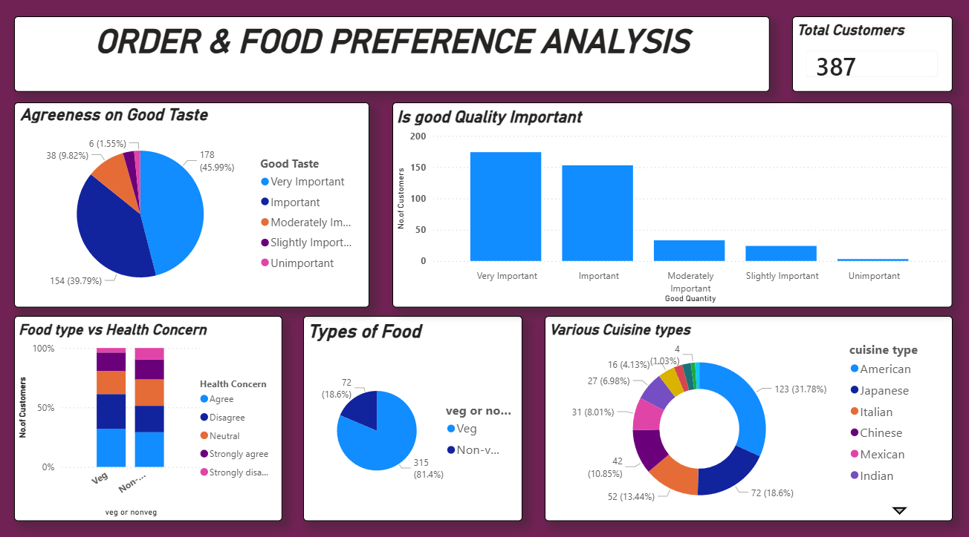
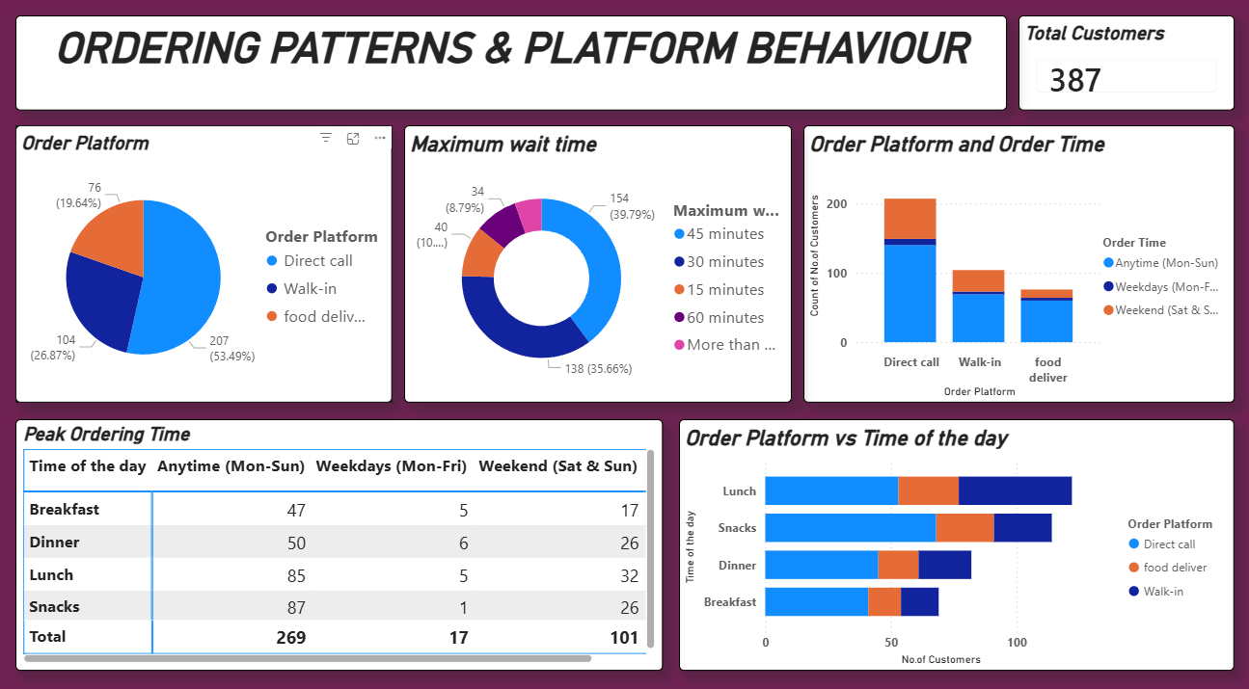
Snapshots

Slide 6
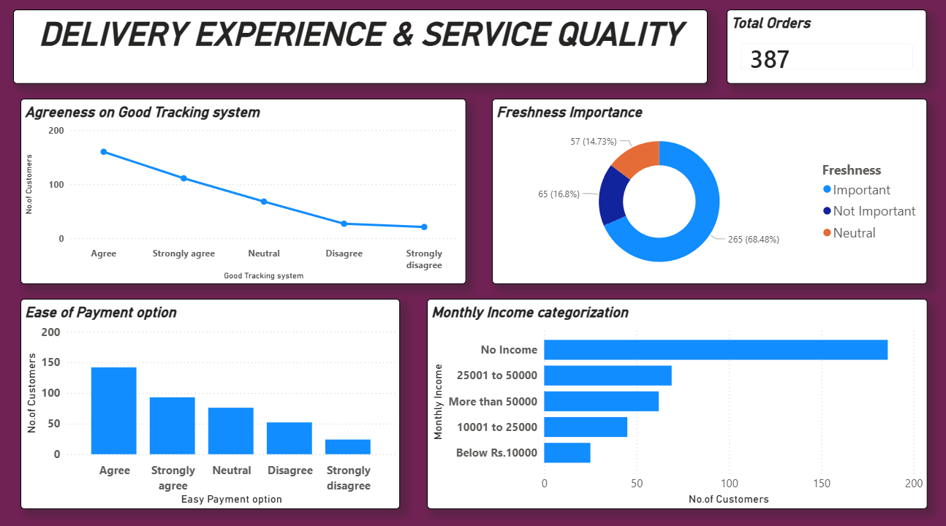
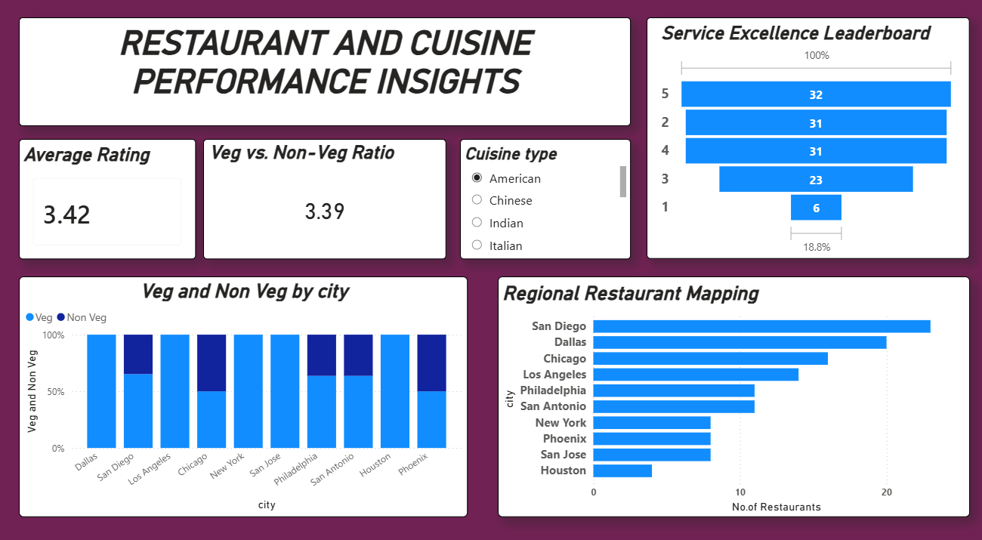
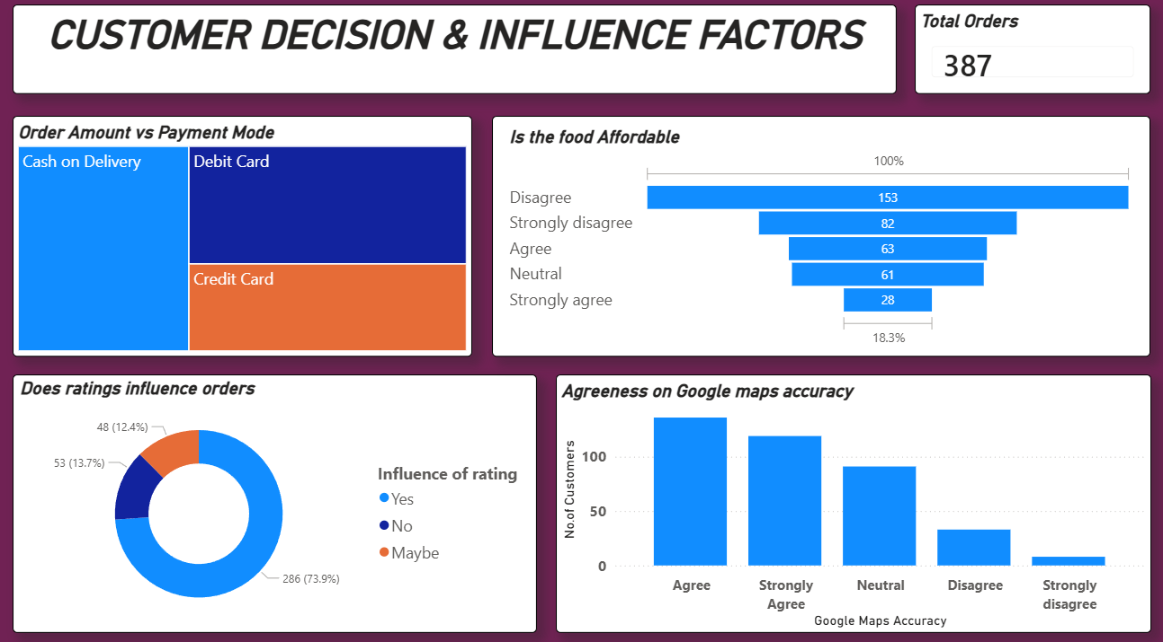
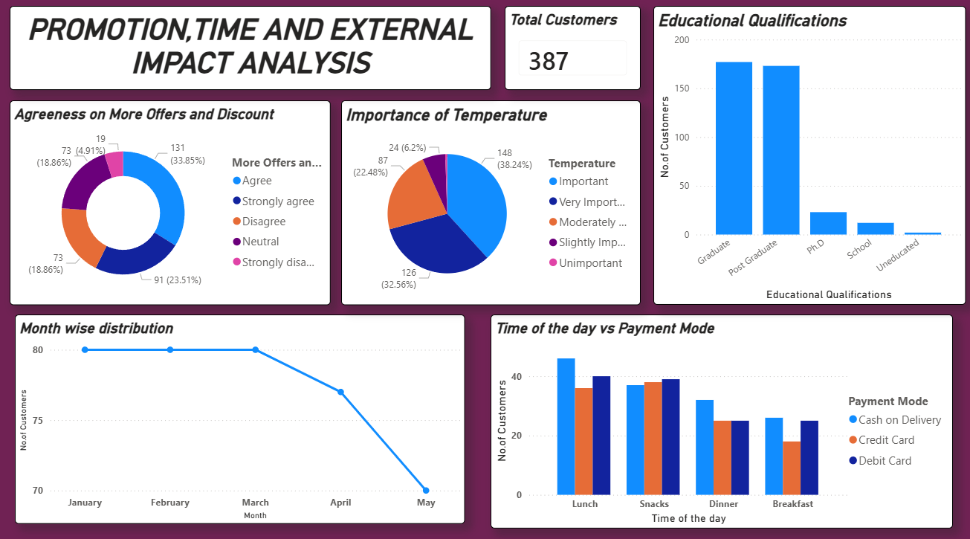

Slide 7
Challenges Faced and Resolution
Challenge 1: Data Segmentation Across Multiple Attributes The dataset included numerous demographic, preference, and behavioral attributes, making it challenging to segment the data meaningfully for analysis. Resolution: Structured the analysis into themed dashboards to ensure clarity and focused insights.
Challenge 2: Interpreting Subjective Customer Feedback Several variables such as Taste, Freshness, Affordability, and Ratings were perception-based, which made it difficult to quantify customer sentiment effectively. Resolution: Used appropriate visualizations like donut charts and stacked bars to clearly represent opinion distributions.
Challenge 3: Identifying Clear Time-Based Patterns Multiple time-related fields such as Order Time, Time of Day, and Monthly Trends created overlapping insights during visualization. Resolution: Carefully separated time variables across different visuals to avoid redundancy and highlight meaningful patterns.

Slide 8
Learnings and Skills Used
Tools
Power BI: Used to create interactive dashboards and perform visual storytelling for customer behavior analysis.
Microsoft Excel: Used for data entry, basic preprocessing, sorting, and validation of the dataset.
Data Science & Visualization Skills
Interactive Dashboarding: Built dynamic dashboards with slicers to filter data by City, Gender, and Time of the Day.
Visual Analytics: Used bar charts, donut charts, line charts, and funnel visuals to analyze cuisine preferences and ordering patterns.
Data Preparation: Connected Excel data to Power BI and managed dimensions and measures for analysis.
Domain Knowledge
F&B Business Framework (4 Ps): Applied Product (Veg/Non-Veg), Price (Affordability), Place (Order Platform), and Promotion (Offers and Ratings).
Customer Segmentation: Grouped customers into health-conscious and value-oriented segments based on preferences.
Soft Skills
Visual Storytelling: Presented insights in a structured flow using dashboards.
Collaboration: Worked as a team to identify key KPIs for analysis and presentation.

Slide 9
Key Insights and Future Enhancement
Key Insights
Student Influence: A large share of customers are students with no income, yet they actively place orders, particularly for veg food and snacks, highlighting strong convenience-driven behavior.
Trust Factors: Google Maps accuracy and order tracking systems are rated as important by a majority of customers, indicating that transparency and reliability significantly impact satisfaction.
Health Trend: Customers who strongly agree on health concerns show a clear preference for veg food, reflecting a growing health-conscious ordering pattern.
Future Enhancements
Machine Learning Integration: Develop a recommendation system based on past orders and customer ratings to personalize food suggestions.
Real-Time Analysis: Integrate live data from food delivery platforms to analyze peak-hour trends and dynamic customer behavior.

Slide 10
Conclusion
The analysis indicates that modern F&B customers place equal importance on convenience and trust, alongside food quality. Factors such as faster delivery timelines, transparent order tracking, and reliable ratings play a critical role in shaping customer satisfaction and repeat usage. Additionally, affordability and health-conscious food choices emerge as key decision drivers, particularly among the younger, student-dominated customer segment. To succeed in this competitive market, F&B brands must adopt a balanced strategy that integrates efficient service, trustworthy digital experiences, and value-driven, health-oriented offerings.

Slide 11
Acknowledgement and References
Acknowledgement:
We thank Infosys Springboard for providing the platform to apply our analytical skills and our mentor for their guidance throughout the milestones.
References:
Dataset: order final.xlsx (Provided by Infosys Springboard)
Python Documentation (Pandas/Seaborn)
F&B Industry Reports 2024.

Slide 12
Thank You

